Slide 1
The Implementation of Complementary Filter Using Arduino Mega 2560 & MPU 9255
Kadircan KURTULUŞ
16015001

Slide 2
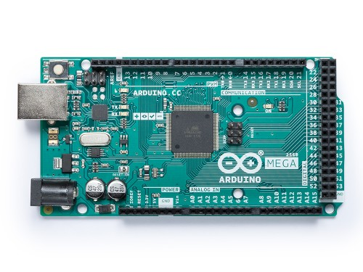
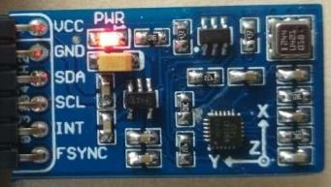
What have we talked about so far?
The general structure of an accelerometer and a gyroscope
The measurement of the acceleration and angular velocity
An introduction to Complementary Filter
Figure 1. Waveshare 10 DOF IMU Sensor ©
Figure 2. Arduino Mega 2560

Slide 3
What will we talk about next?
Features of MPU9255
Introduction to I2C interface
Wiring diagram of Arduino Mega 2560 & MPU9255
The implementation of complementary filter on s-domain
Conversion of the implementation to z-domain
Writing the algorithm on Arduino Mega 2560 in C++
Visualizing the data on the computer program written in C#

Slide 4
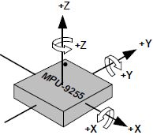
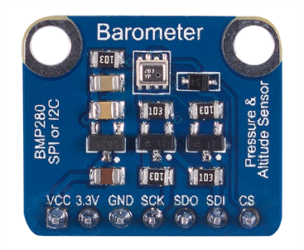
Waveshare 10 DOF IMU Sensor ©
Waveshare 10 DOF IMU Sensor © is used on the project.
This sensor supports I2C and consists of 2 integrated circuits:
MPU9255 (3-axis accelerometer, gyroscope and digital compass)
BMP280 (Digital pressure sensor)
Digital compass and second IC are not used on the project.
Figure 3. Oriantations of axes of MPU9255
Figure 4. BMP280 Digital pressure sensor

Slide 5
MPU9255
This IC:
is built-in 16 bit ADC.
has ±250, ±500, ±1000 and ±2000°/s gyroscope ranges.
has ±2, ±4, ±8 and ±16g gyroscope ranges.
has ±4.8mT compass range.
can be used on quadcopters, action game controllers…

Slide 6
Pin descriptions and I2C interface
Vcc -> 3.3V or 5V power supply
GND -> Supply ground
SDA -> I2C serial bus data (Serial Data)
SCL -> I2C serial bus clock input (Serial Clock)
I2C is a synchronous serial communication protocol. So that, data is transferred bit by bit along a single SDA wire and masters and slaves are synchronized by SCL clock signal. On the project, Arduino is used as a master and this master controls the clock signal.

Slide 7
Wiring descriptions
IMU Sensor Vcc -> Arduino Mega 2560 5V
IMU Sensor GND -> Arduino Mega 2560 GND
IMU Sensor SDA –> Arduino Mega 2560 Pin 20 (SDA)
IMU Sensor SCL –> Arduino Mega 2560 Pin 21 (SCL)
Potentiometer Pin 1 -> Arduino Mega 2560 5V
Potentiometer Pin 2 -> Arduino Mega 2560 Pin A0
Potentiometer Pin 3 -> Arduino Mega 2560 GND

Slide 8
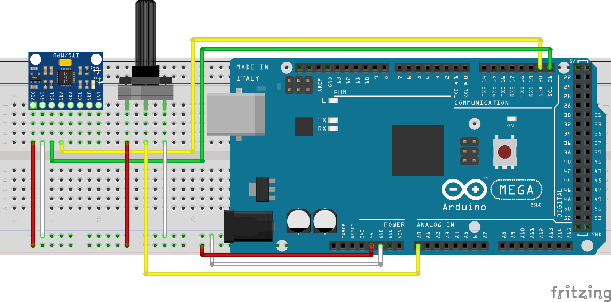
Wiring diagram

Slide 9
Obtaining the angular position
Our aim in the project is measuring the angular (torsional) vibration.
To do this, we need to measure the angular position of the IMU.
There are 2 algorithms to obtain the angular position from the IMU:

Slide 10
Dead reckoning
Measuring an axis’ angular velocity from gyroscope and integrating it.
This algorithm is called as «dead reckoning».This gyroscope data is reliable on the short periods of time. This periods depends on the noise and error characteristics of the gyroscope. Due to integrate, any uncorrect velocity data and high frequency noise will be included and this will cause the estimated angular position to drift. This measurement is relative and there is no absolute measurement which will correct.

Slide 11
Using the accelerometer
Measuring other axes’ linear accelerations from the accelerometer and taking arctangent of the fraction of these.
This accelerometer data is not reliable on the short periods of time, because it is also noisy and measures all accelerations. If IMU accelerates (shakes for example) any direction, the measurement is no longer just from gravity. The data is reliable on the long periods of time, because gravity does not change in time.

Slide 12
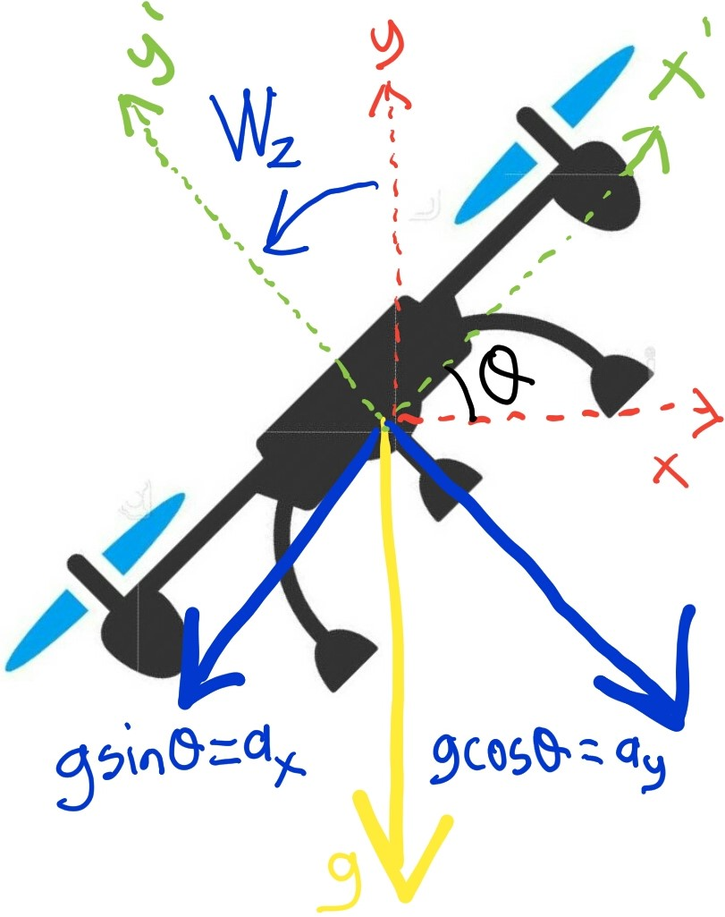
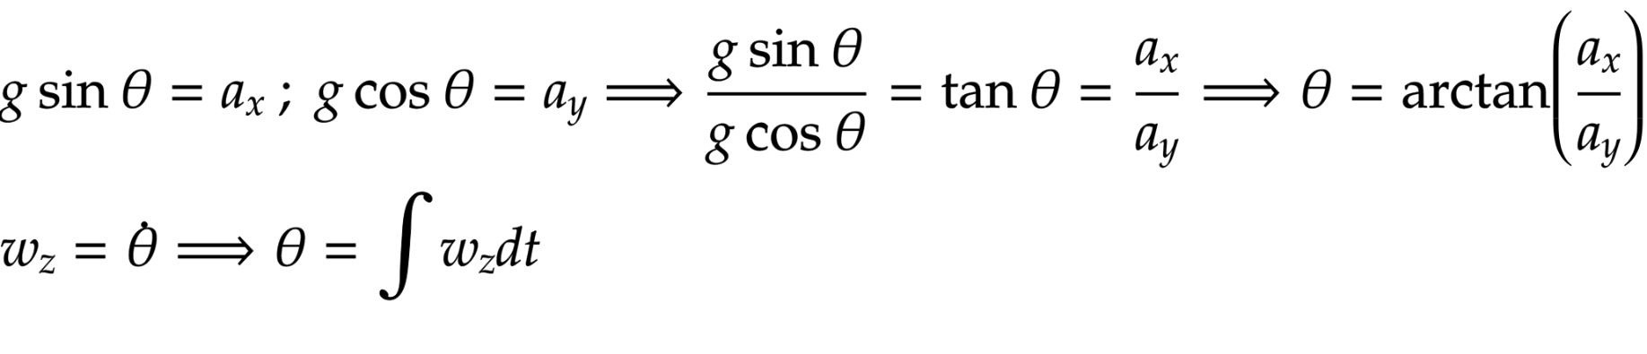
Estimation of the angular position
Assume that a drone is stationary on air.
Blue datas can be obtained from IMU.
Using these datas, angular position can be estimated:

Slide 13
Implementing the filter on s-domain
The datas are obtained from IMU, and ready to be used.
It is known that the gyroscope data is reliable on short term and the accelerometer data is reliable on long term.
So, it will be wise to keep the short term benefits of the gyroscope and the long term benefits of the accelerometer.
To do this; the accelerometer data can be passed through a LPF and the gyroscope data can be passed through a HPF.
If these filters are complementary of each other, outputs can be summed and the angle can be estimated.

Slide 14
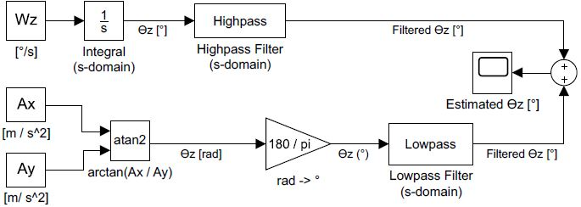
Model 1: First implementation

Slide 15
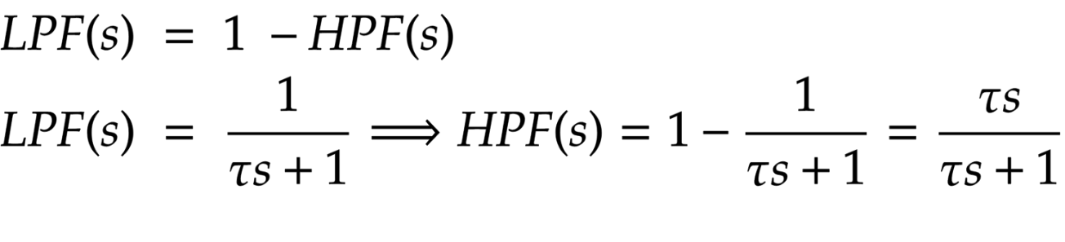
Model 1: Details
Angular position which is obtained from gyroscope and angular position which is obtained from accelerometer are the same in theory.
If they were the same data also in practice, we do not have to use this filter at all!
To make the implementation simpler and be possible for digital system, gain blocks are going to be used instead of filters in Model 2.
HPF and LPF are complementary of each other. In mathematics:

Slide 16
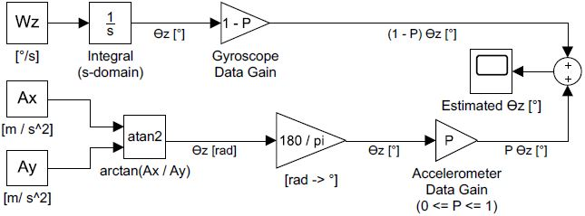
Model 2: Using gain blocks

Slide 17
Model 2: Details
The potentiometer which is connected to the breadboard is going to be used to change the gain P. Changing the gain P is going to change the usages of gyroscope and accelerometer datas.
This model is simpler than the first model. So, implementing the filter in s domain is completed.
This model is going to be used in Arduino, which is a digital system.
To use this model in Arduino like digital systems, blocks in s domain must be transformed into z domain.
This model has only a integrator in s domain. There are 6 discretization methods commonly used :

Slide 18
Discretization methods
ZOH -> Zero order hold on the inputs
FOH -> First order hold on (linear interpolation of) inputs
Impulse -> Impulse-invariant discretization
Tustin -> Bilinear approximation.
Matched -> Matched pole-zero method
Least Squares -> Least-squares minimization of the error between frequency responses of the continuous and discrete system.

Slide 19
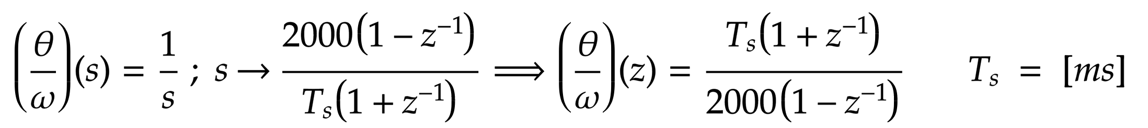
Bilinear Method
Bilinear method is used in the project. Integrator in s domain transforms into z domain like this:
Model 3 is the discretizated model of Model 2.

Slide 20
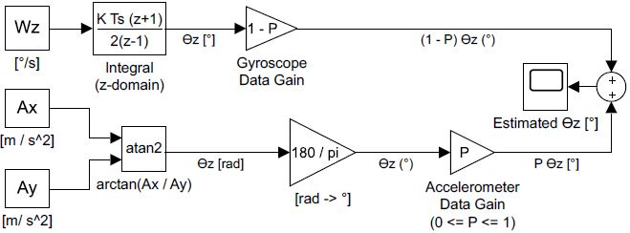
Model 3: Discretizated Model

Slide 21
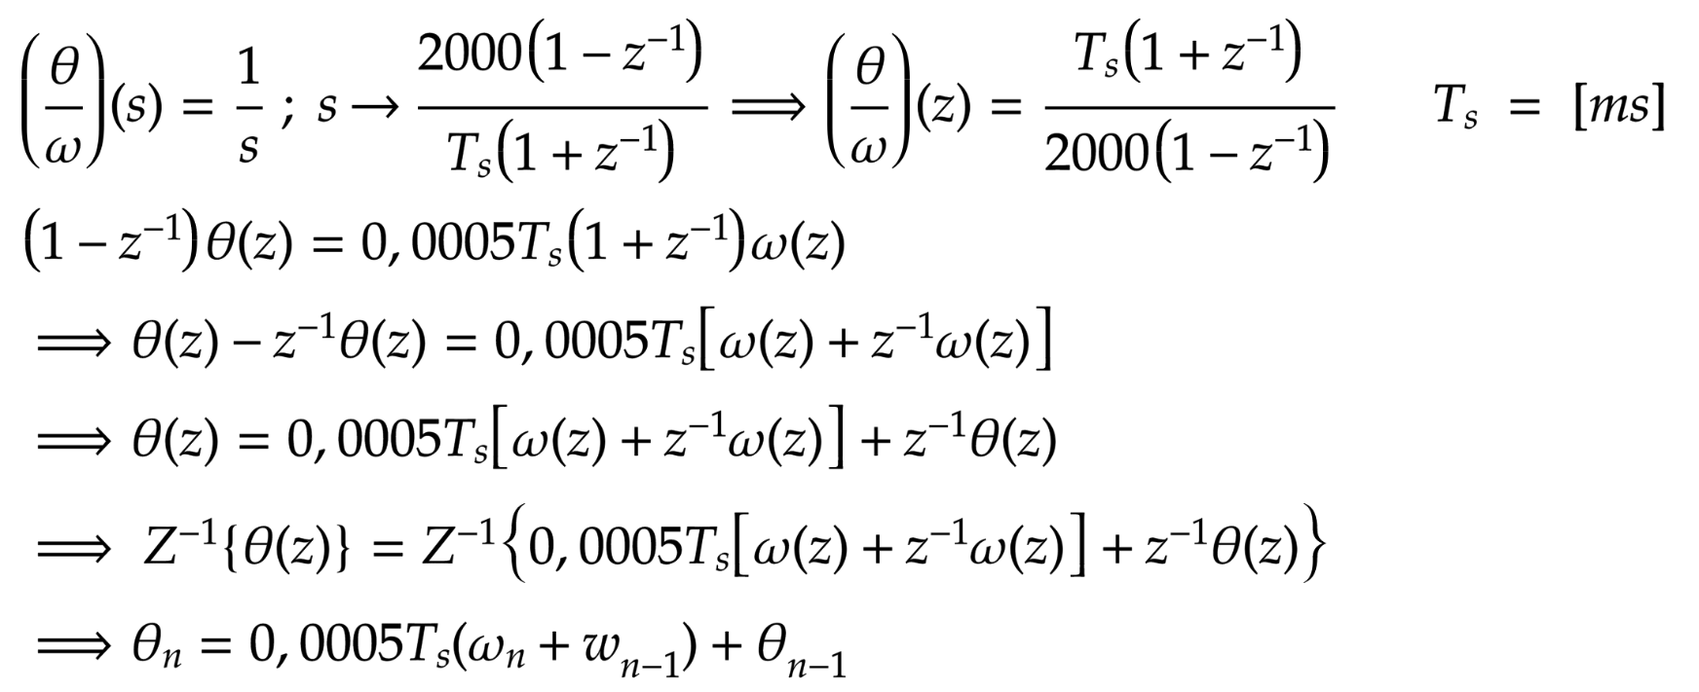
Model 3: Details
This is the main model we used in Arduino.
To implement this filter to Arduino, we need to obtain the differance equation of this integrator block.

Slide 22
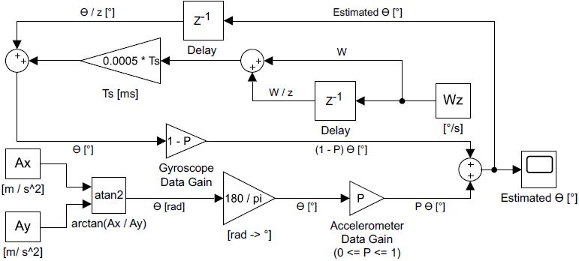
Model 4: Last model

Slide 23
Model 4: Details
Difference equation of the integrator can be seen on this model easily.
This is the detailed model we used in Arduino.
Now, we are going to use this model on Arduino.
Switching to Arduino IDE…

